Slide 1
The Best ESG Fund Manager

Slide 2
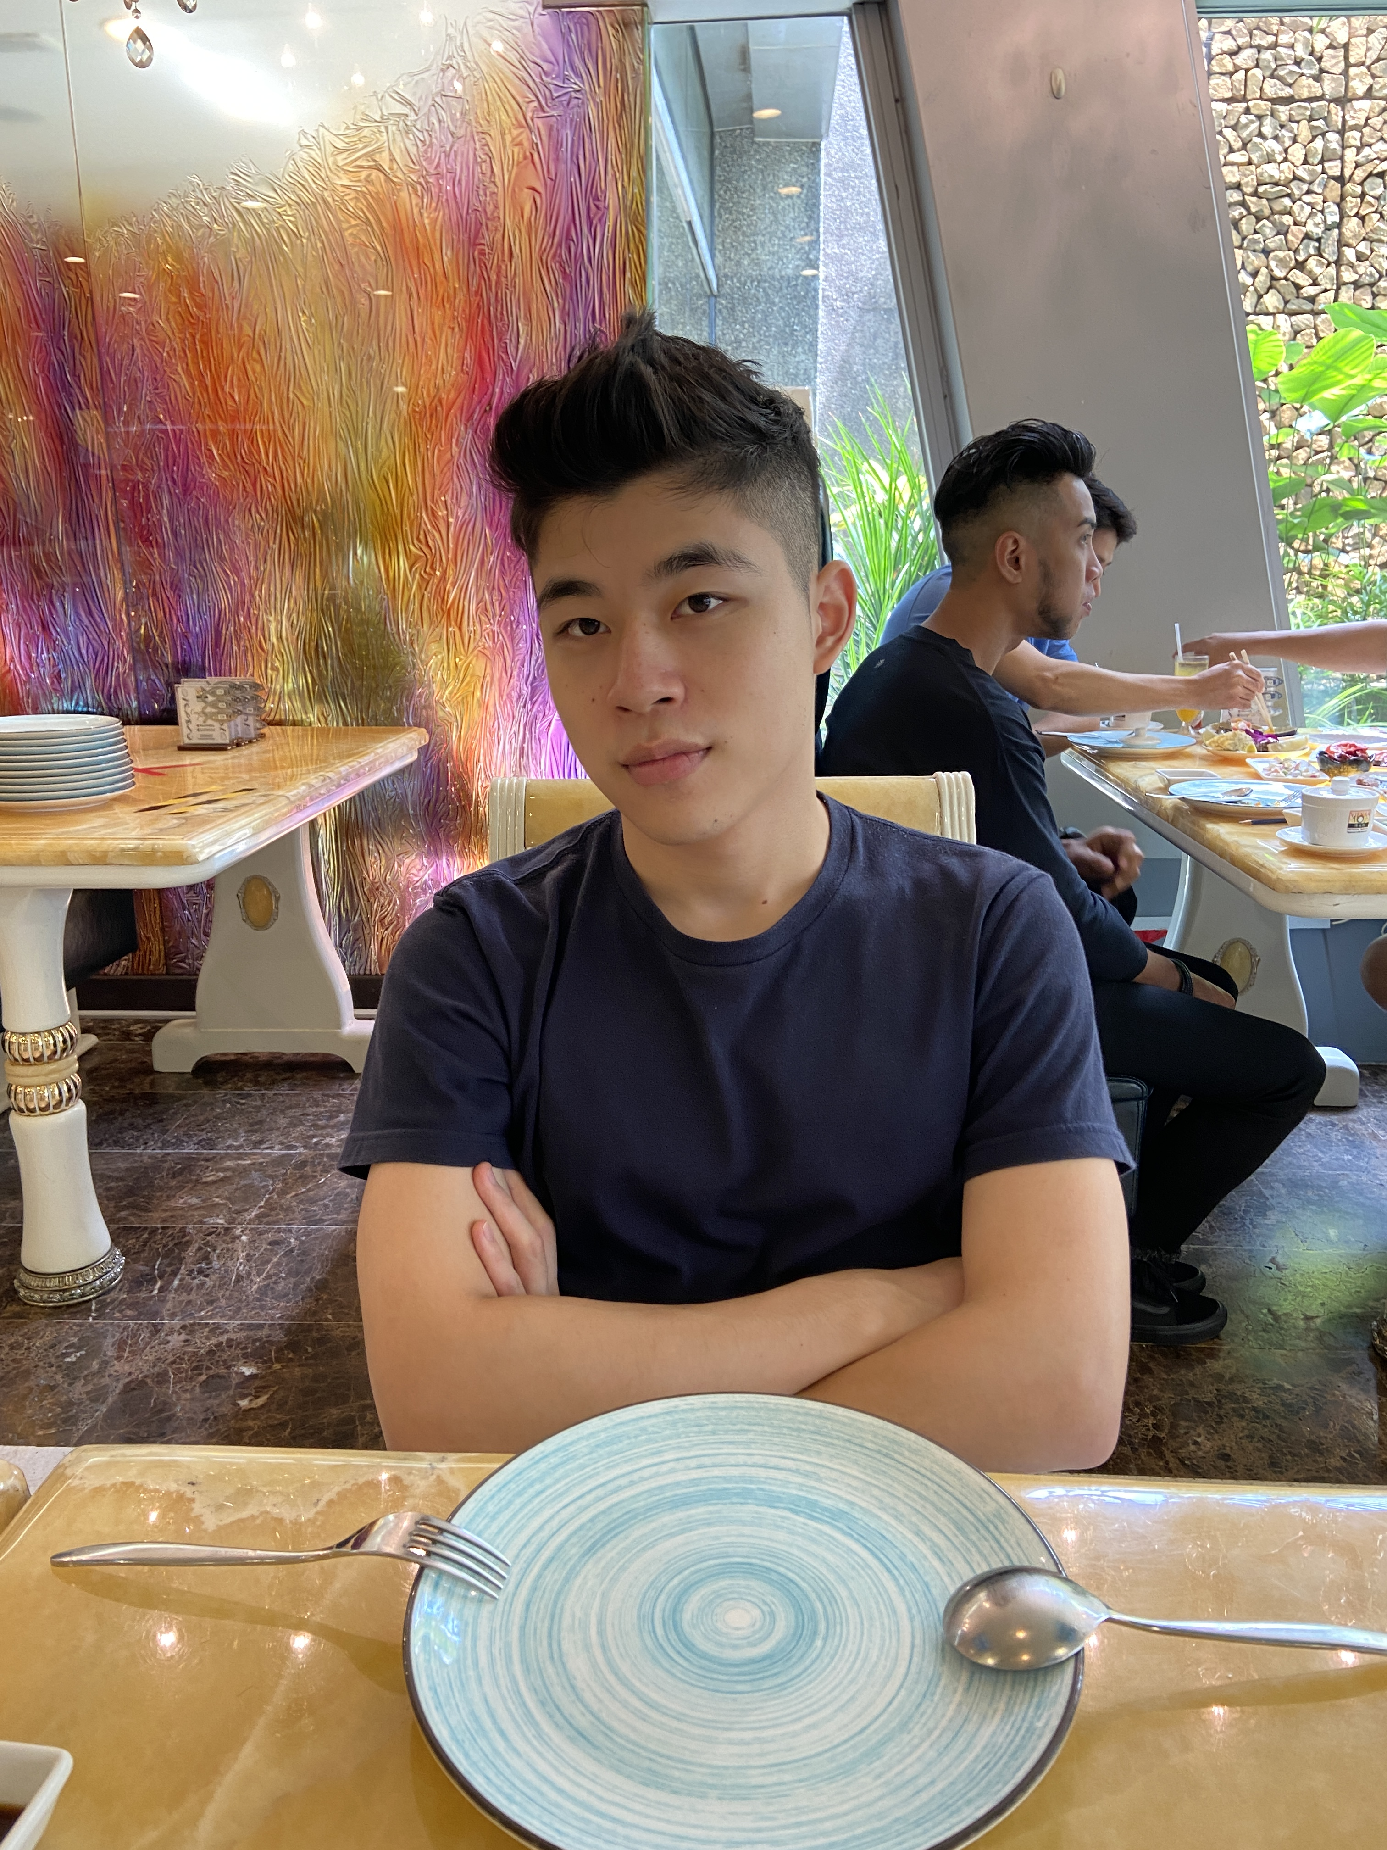
HELLO!
I am XIE YUAN (Jacob)
Software Engineer @ Rakuten
Email: xiey0017@gmail.com
Provide Technical Design and Implementation

Slide 3

HELLO!
I am FAN YANLIN
Senior Equity Dealer @ Phillip Securities
Email: fanyanlinfyl@gmail.com
Provide Financial Knowledge and UI/UX Design

Slide 4
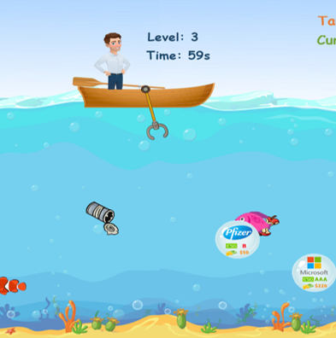
ESG investing is as skillful as Fishing. Timing is the key. Meanwhile, more expensive fishes may not be healthier to human body. Similarly, more profitable stocks may not be more ESG-friendly to our society.

Slide 5
Our Idea
We proposed a game-based approach to raising public awareness on ESG/sustainable investing.
The Player's goal is to invest the companies with good financial returns and good ESG ratings.

Slide 6
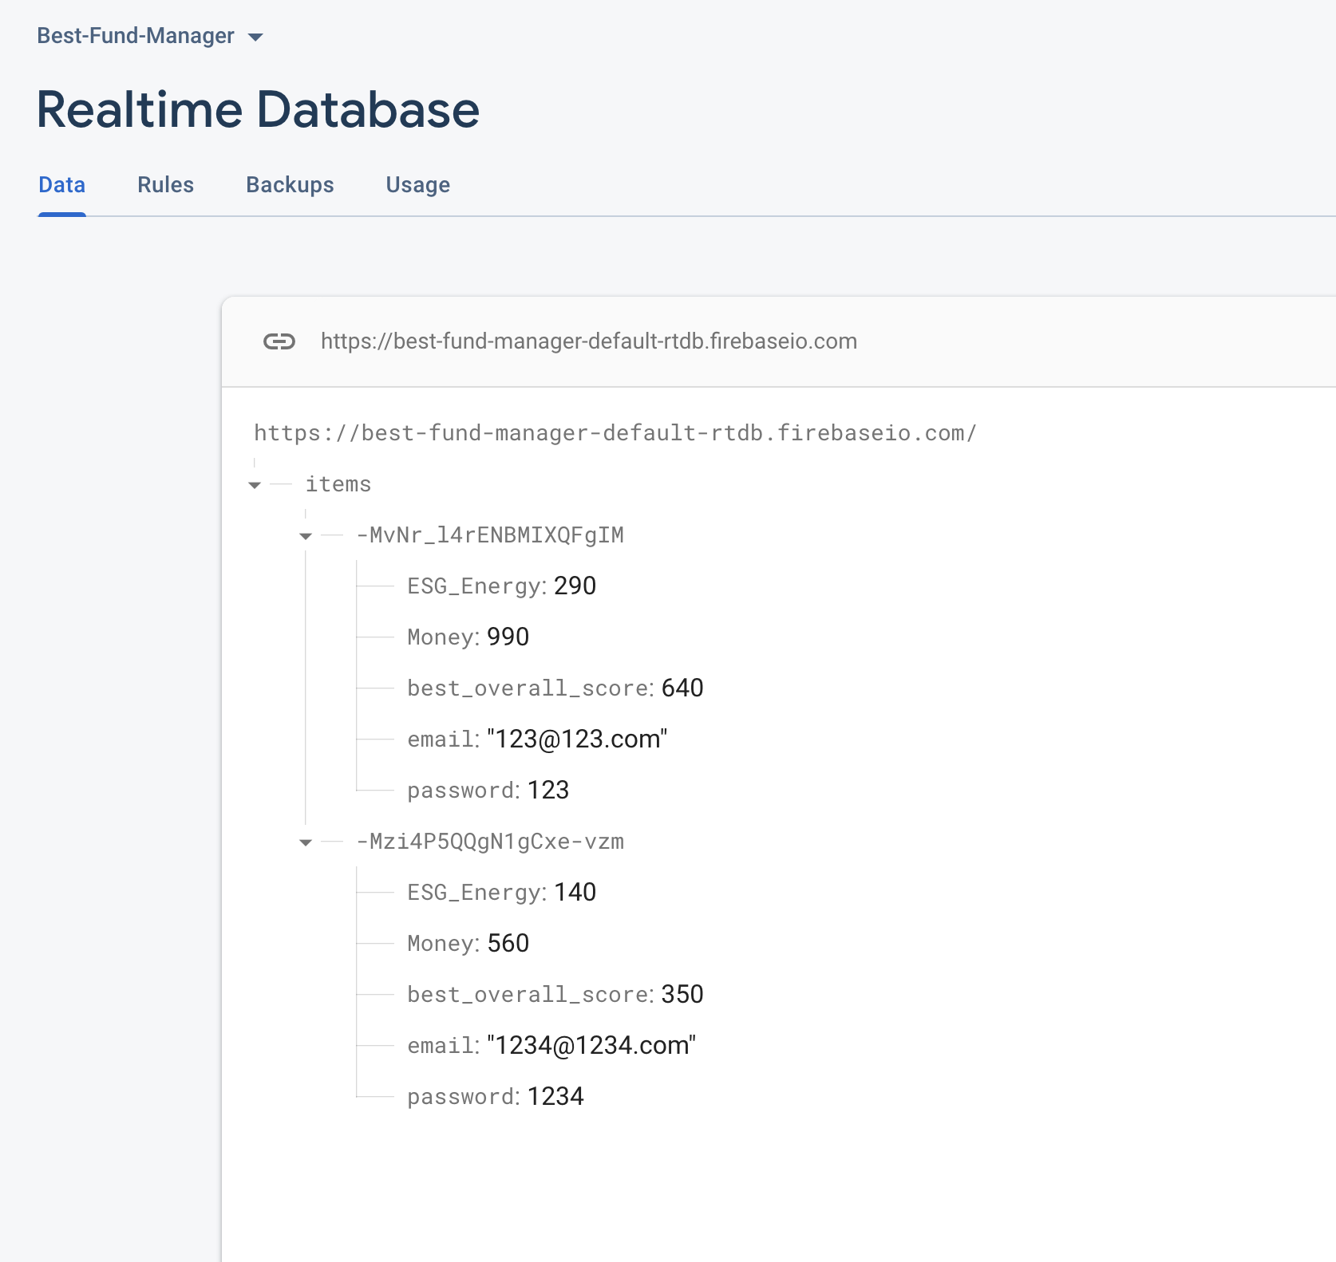
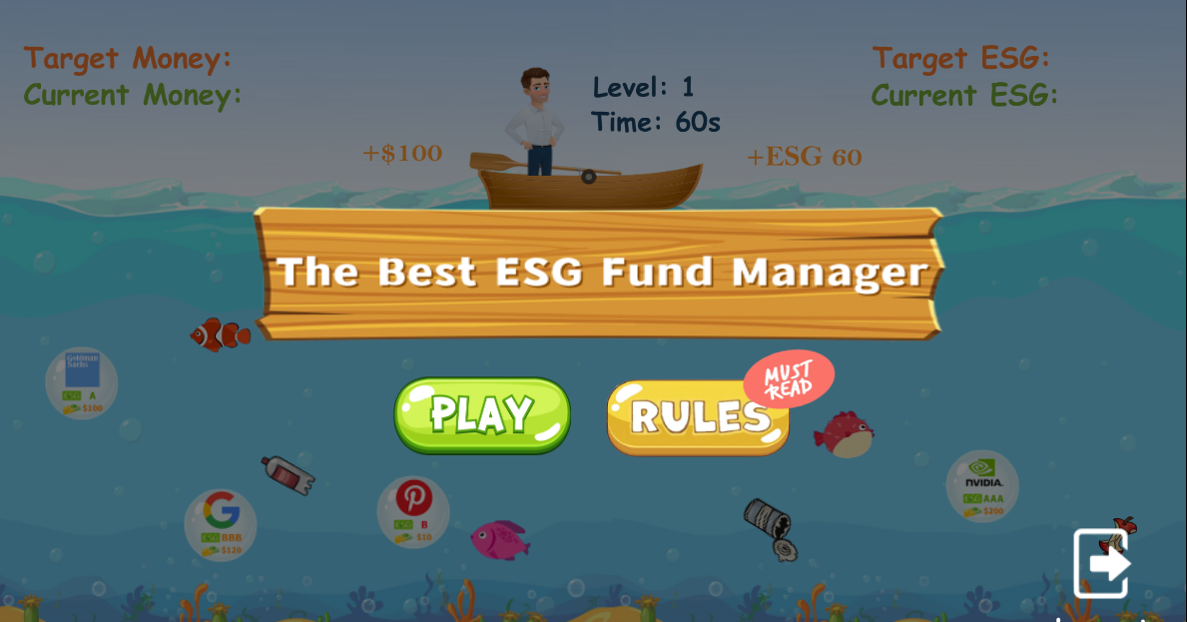

Technical Explanation
Game Development Software: Construct2
Database: Firebase Realtime Database
Create, Update
Fetch
More info on Construct software at https://www.construct.net/en
More info on Firebase software at https://firebase.google.com/

Slide 7
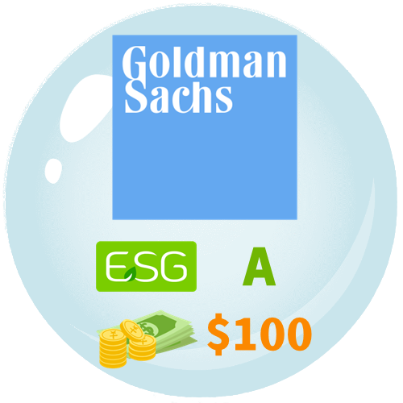


Game Rules
Gain stock profit
Gain ESG score. AAA is 30 scores, AA is 20, A is 10, BBB is 0, BB is -10, B is -20, CCC is -30.
ESG best practice: cleaning up the trash and avoiding capturing fishes
Players need to achieve both targets for money and ESG score.
MSCI ESG rating tool: https://www.msci.com/research-and-insights/esg-ratings-corporate-search-tool

Slide 8
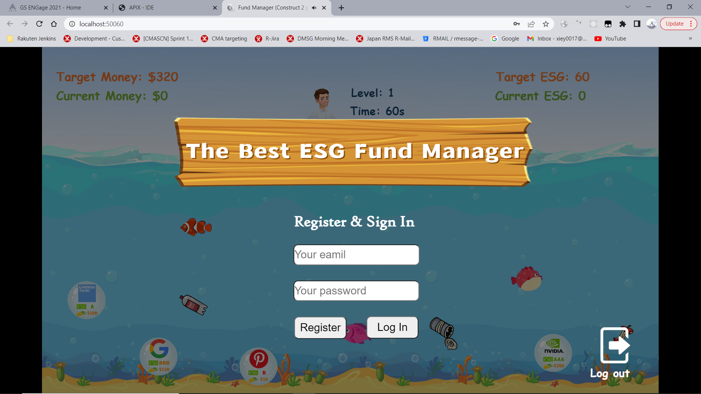
1. Authentication
User Register & Sign In

Slide 9
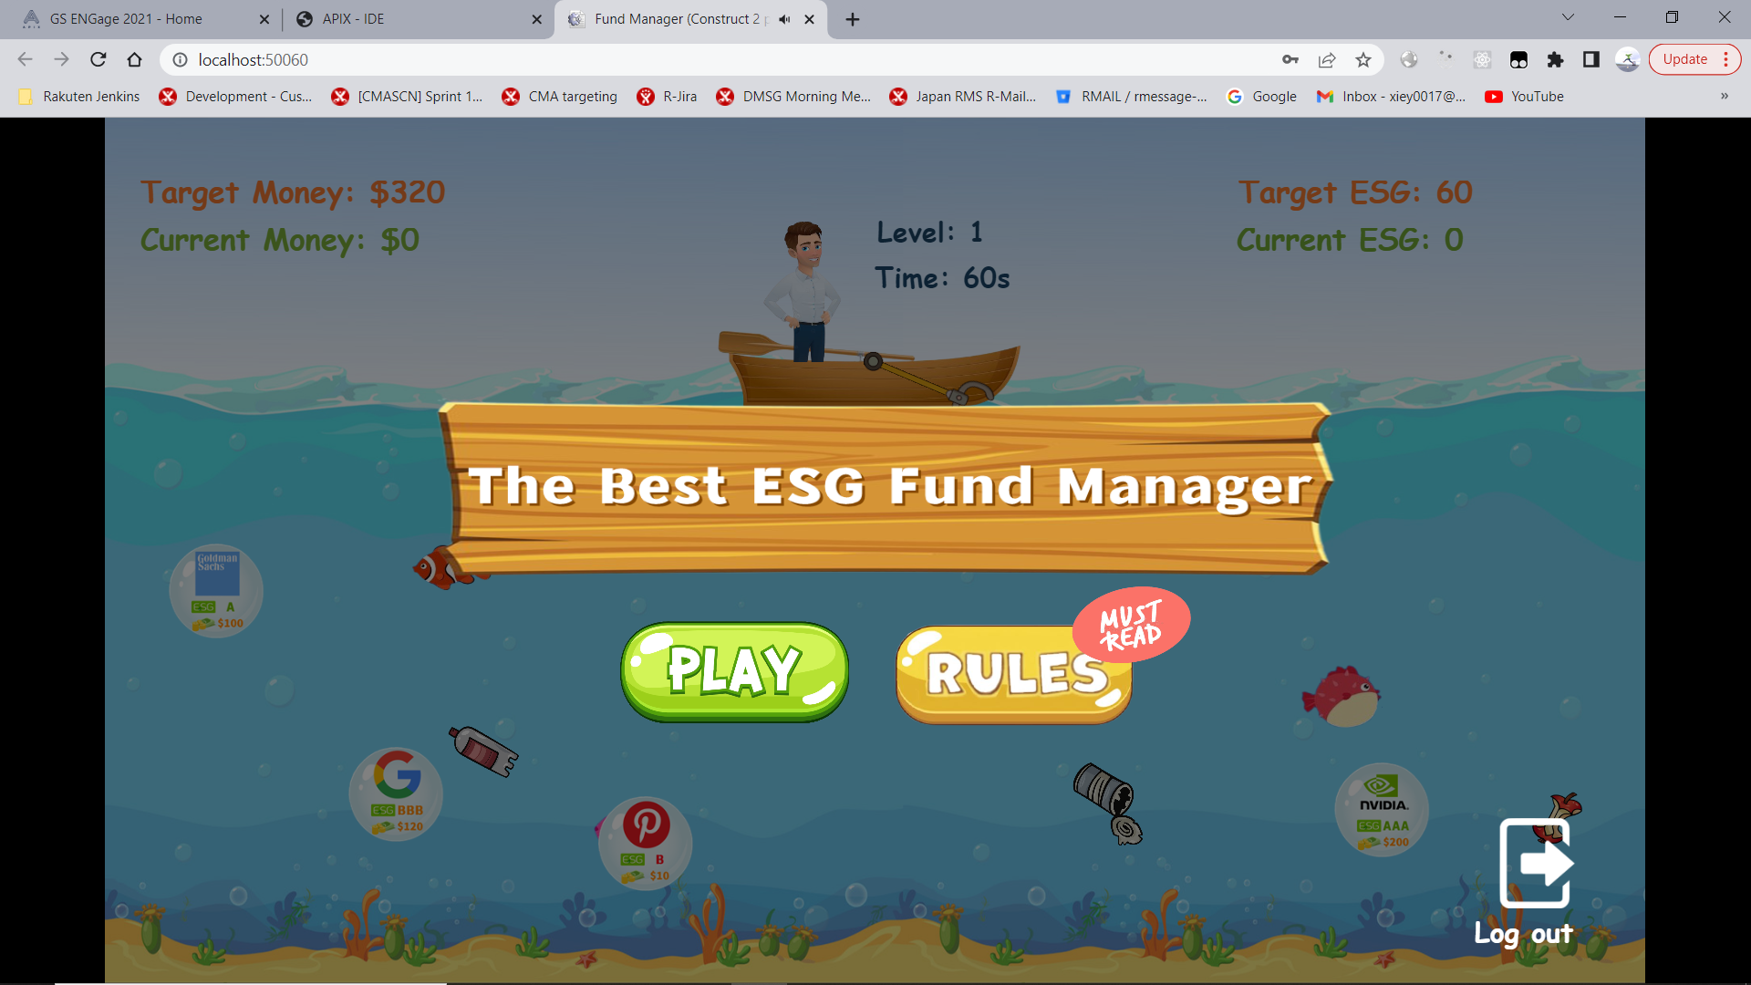
2. Menu
Start game & Instructions

Slide 10
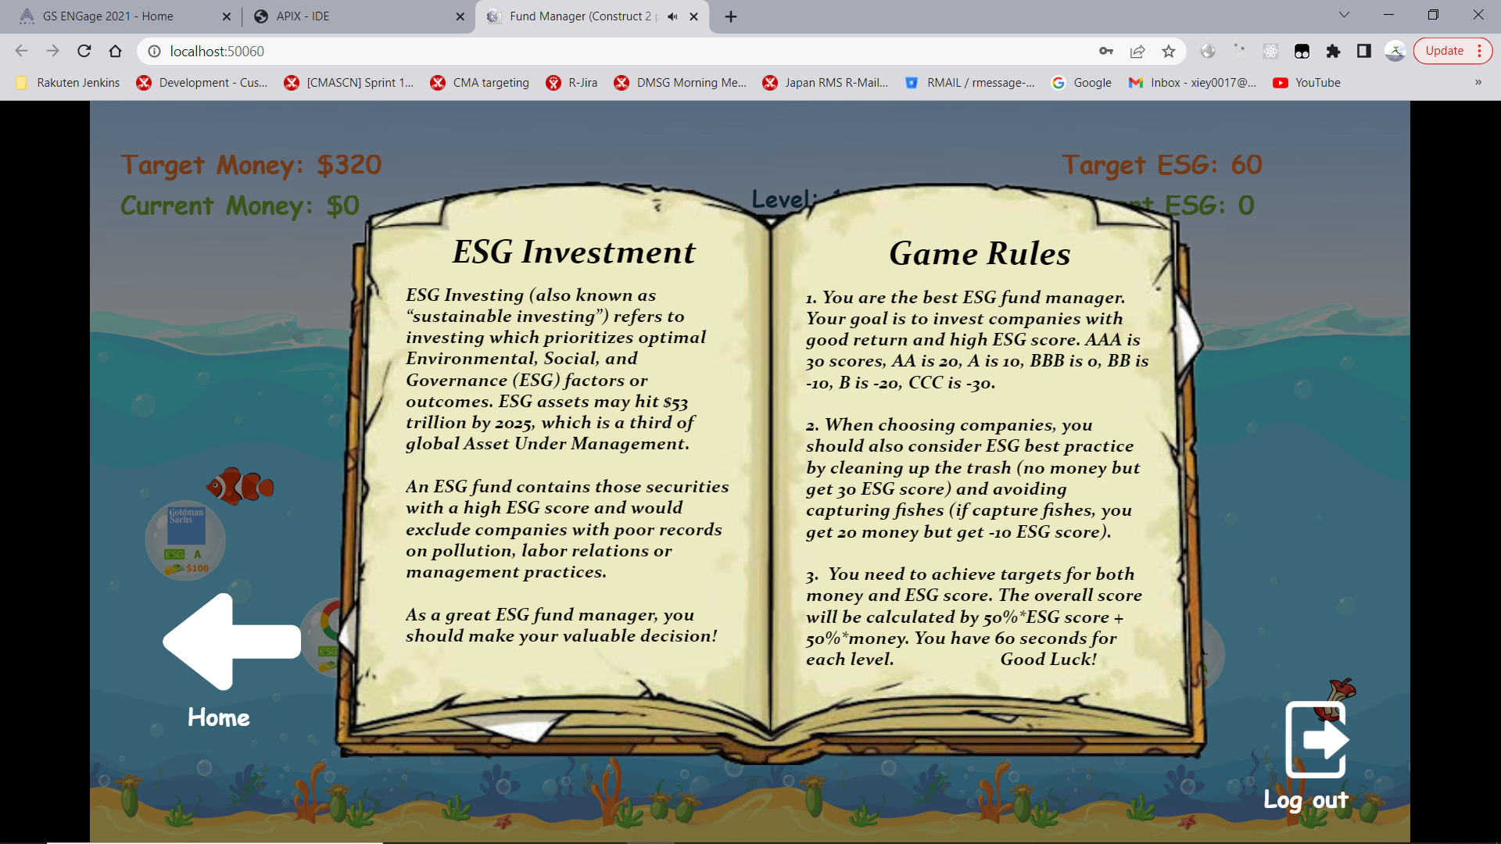
3. Instructions
ESG Investment Intro & Game Rules

Slide 11
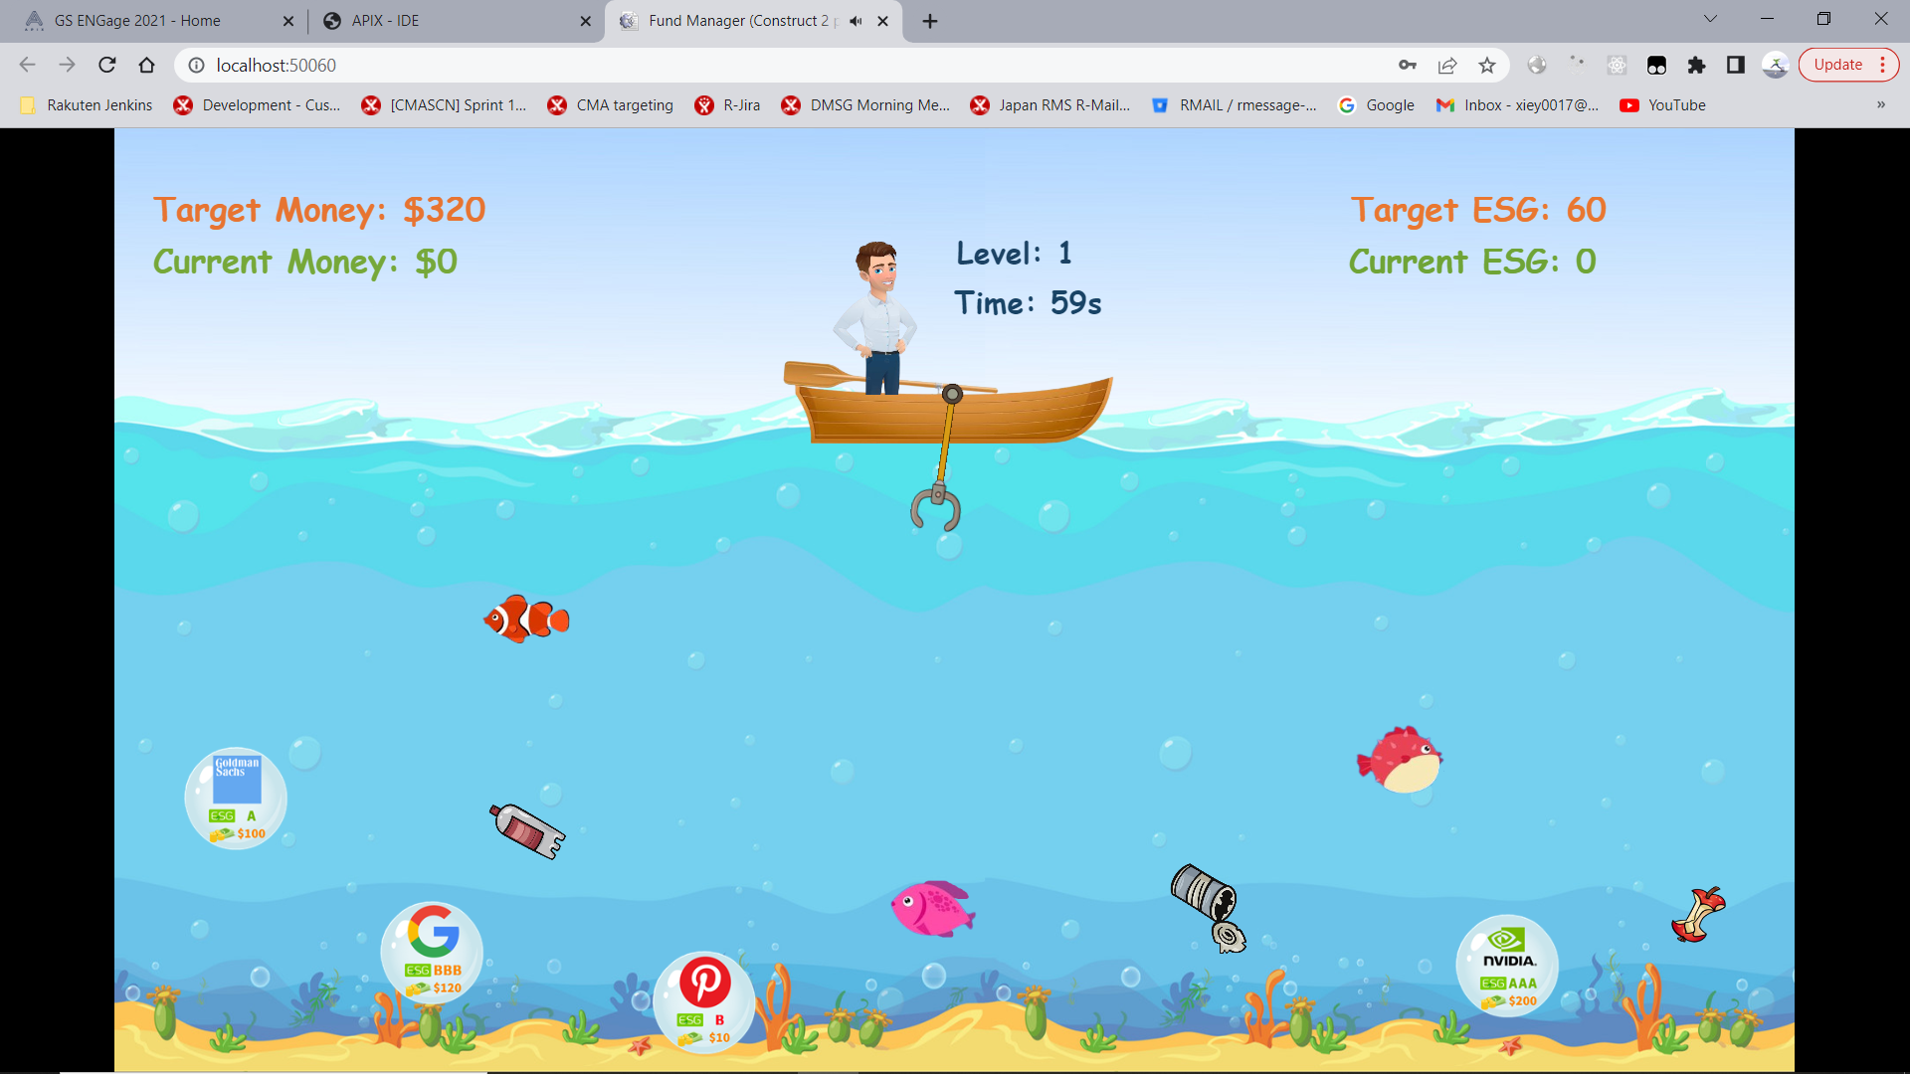
4. Level 1
Start of game
Tap to release hook

Slide 12
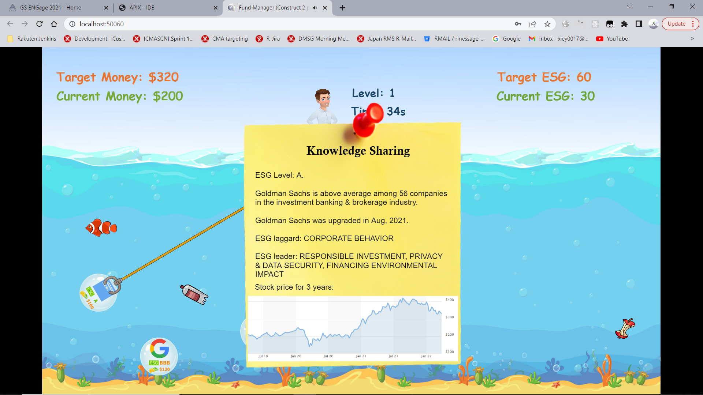
5. Capture Companies
Show ESG rating
Show stock performance
Gain profit and ESG score

Slide 13
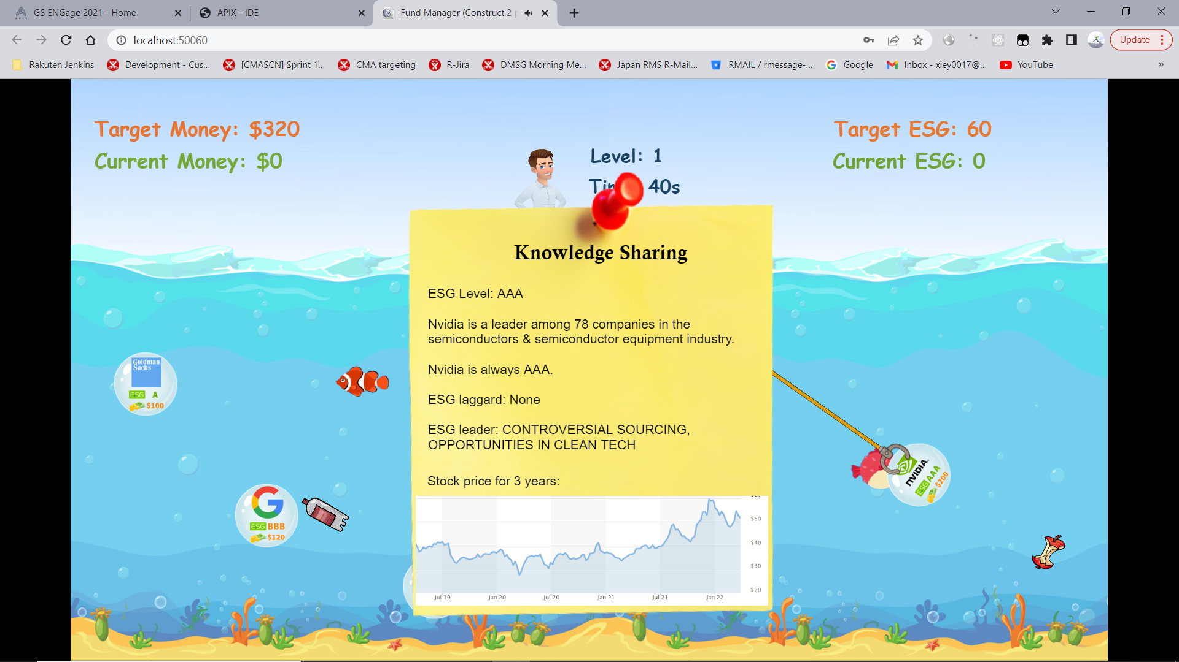
6. Choose Companies
Show ESG rating
Show stock performance
Gain profit and ESG score

Slide 14
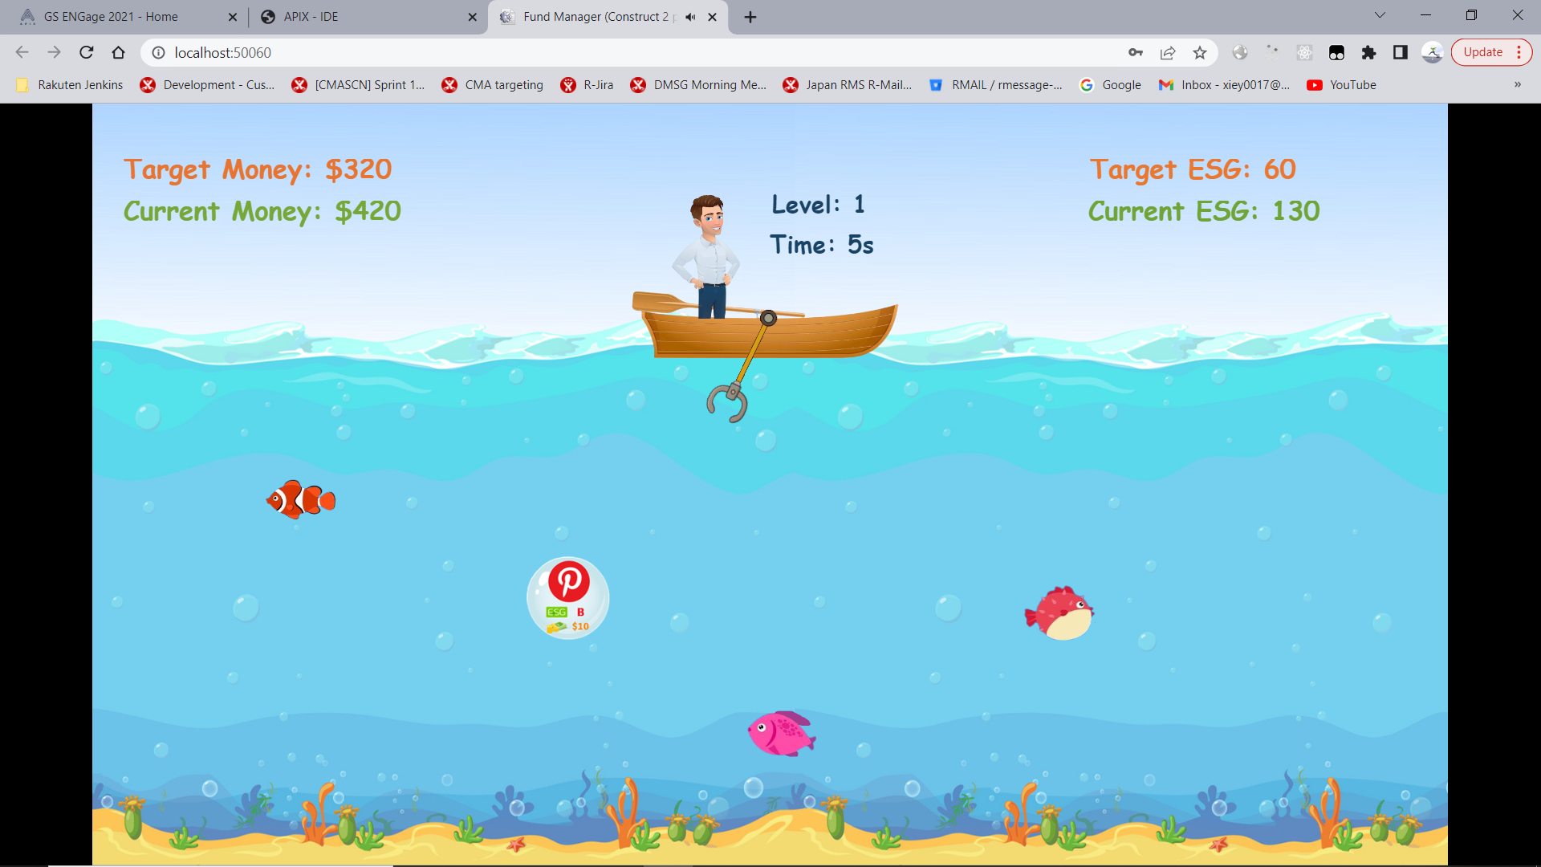
7. Clean Trash
Get more ESG score

Slide 15
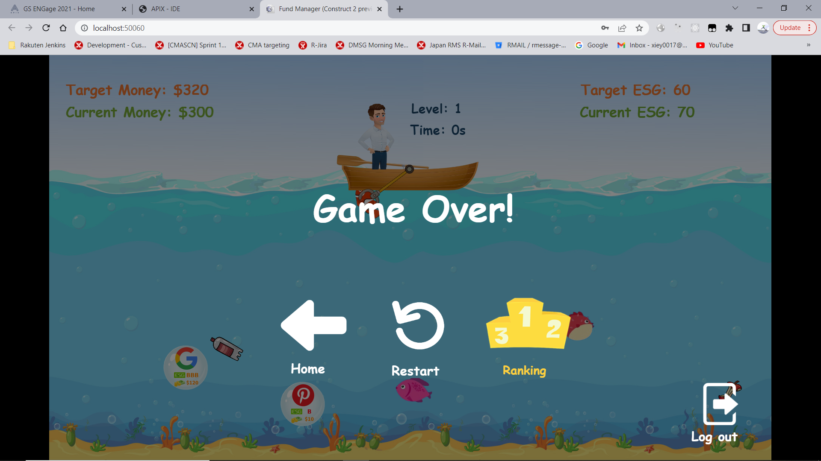
8. Game Over
Targets not reached

Slide 16
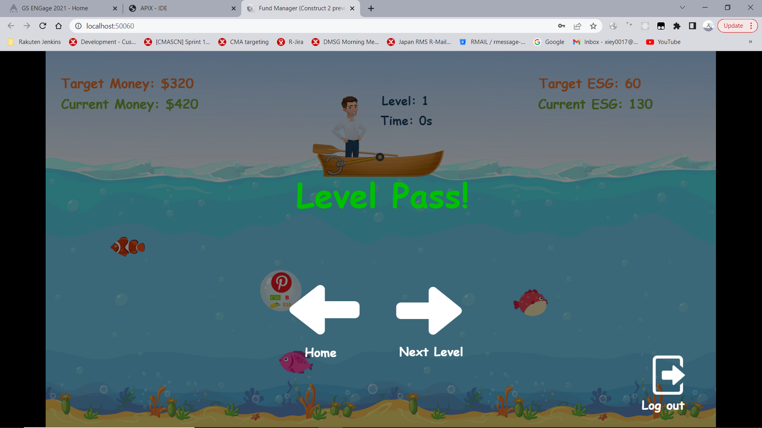
9. Level 1 Passed
Both targets reached

Slide 17
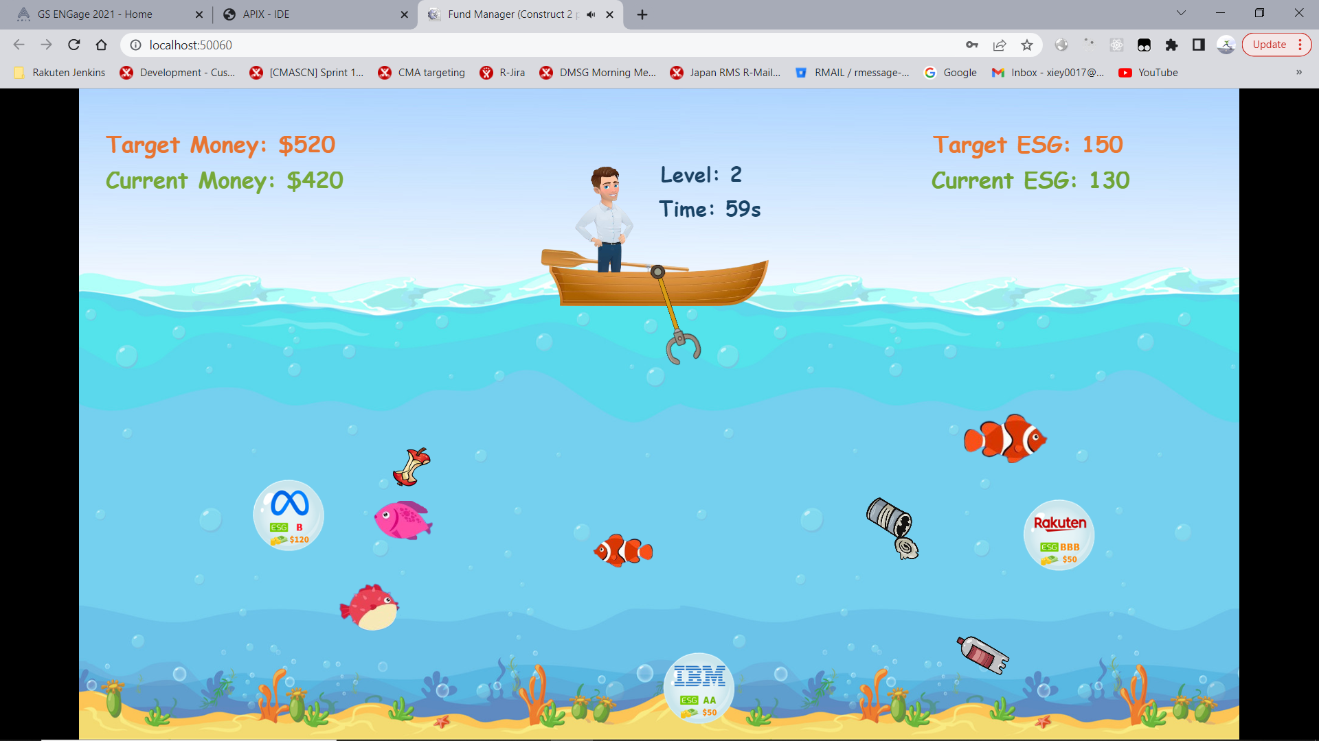
10. Level 2
Accumulated money & ESG

Slide 18
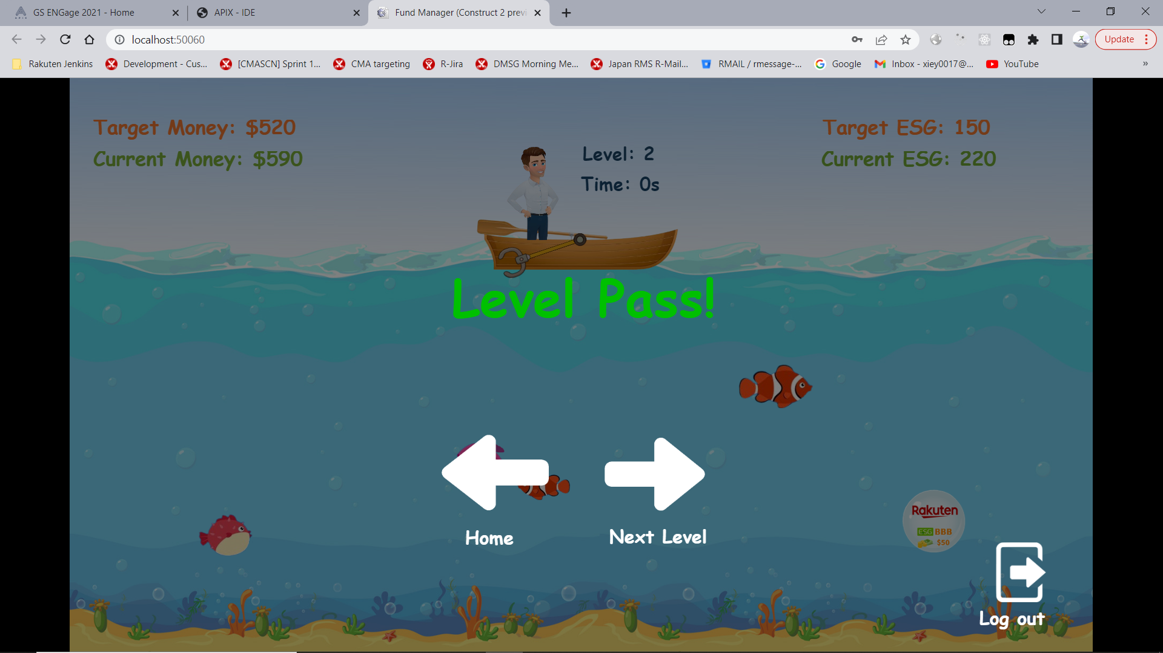
11. Level 2 Passed
Both targets reached

Slide 19
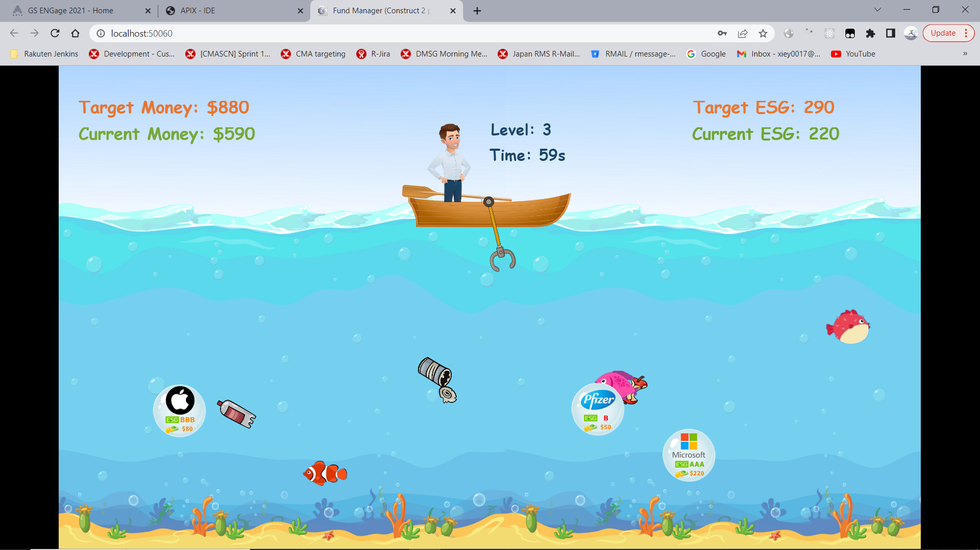
12. Level 3
Accumulated money & ESG

Slide 20
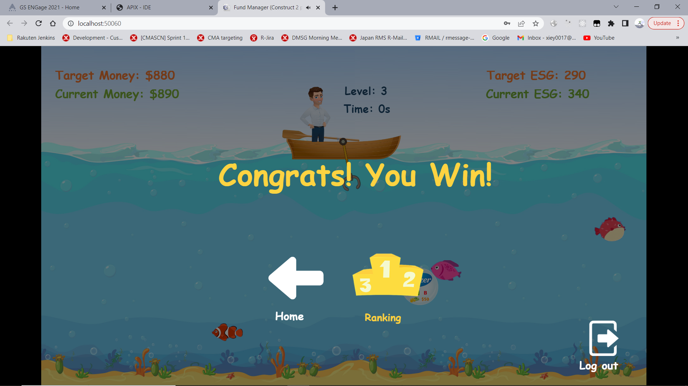
13. Win
Final level passed
Check leader board

Slide 21
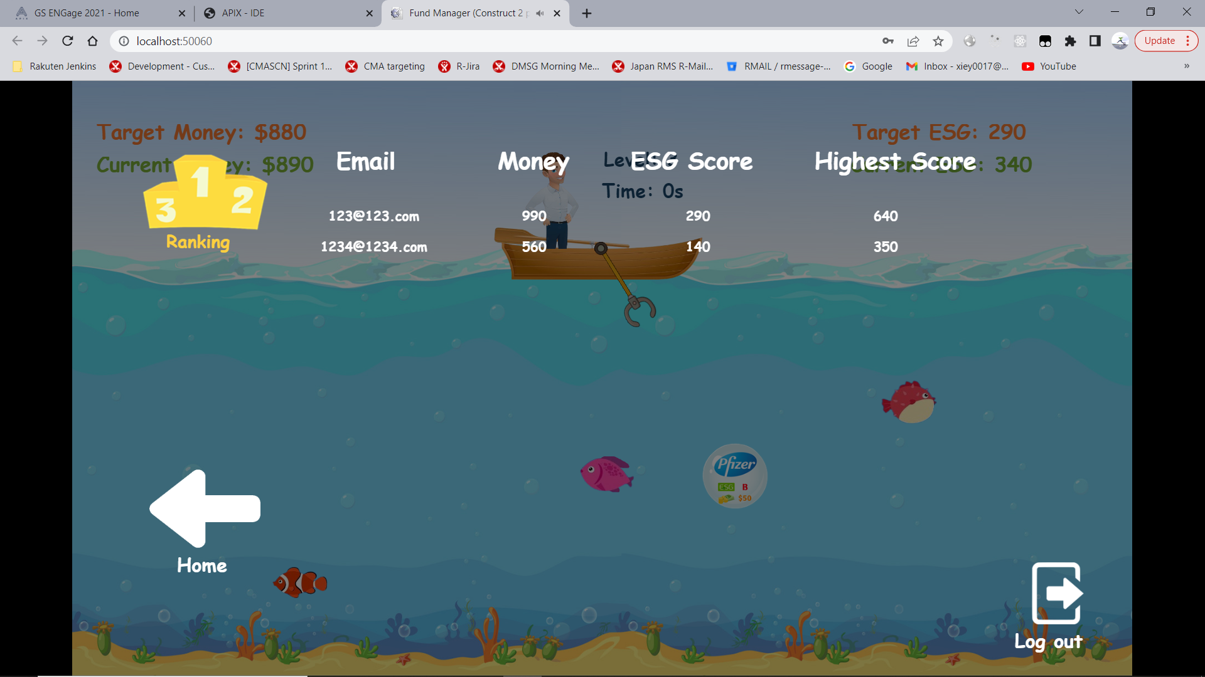
14. Leader Board
Highest scores for players
50%*Money + 50%*ESG

Slide 22
Live Demo
Deployed on APIX
sandbox environment

Slide 23
Future Improvement
Use Construct3
Remove hardcoded values
More Companies
More Levels
Player can choose to invest more shares
…

Slide 24
THANKS!
Q&A

